Slide 1
Mobil Application Design
Assignment 3

Slide 2
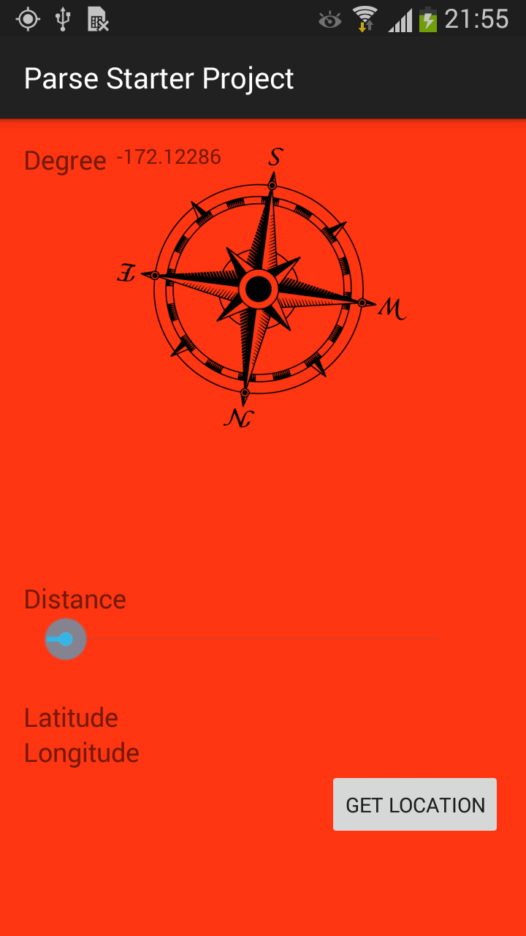
Initial state

Slide 3
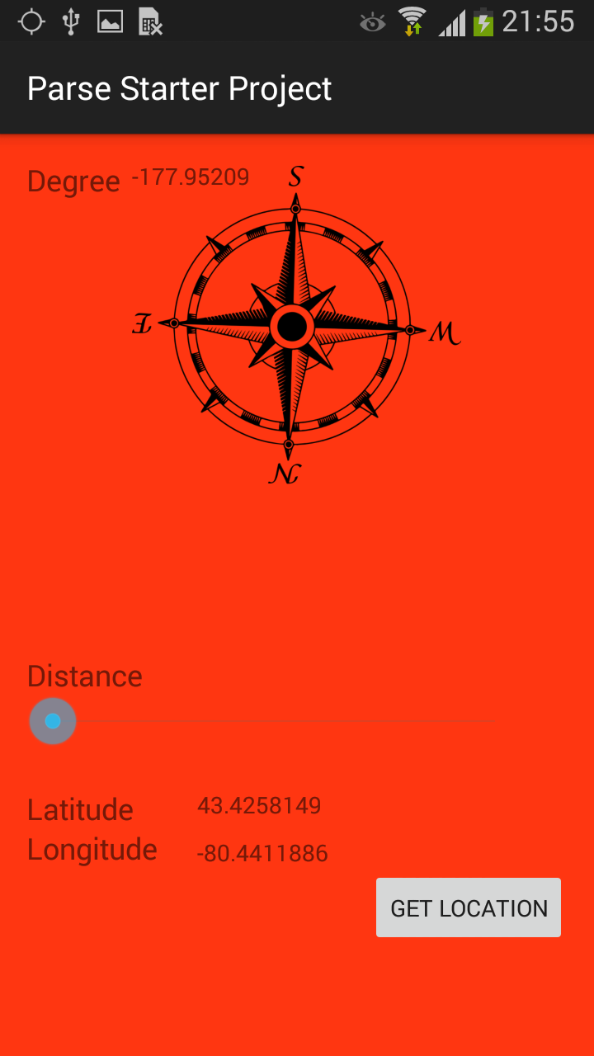
After Clicking on button it send GPS coordinates to parse

Slide 4
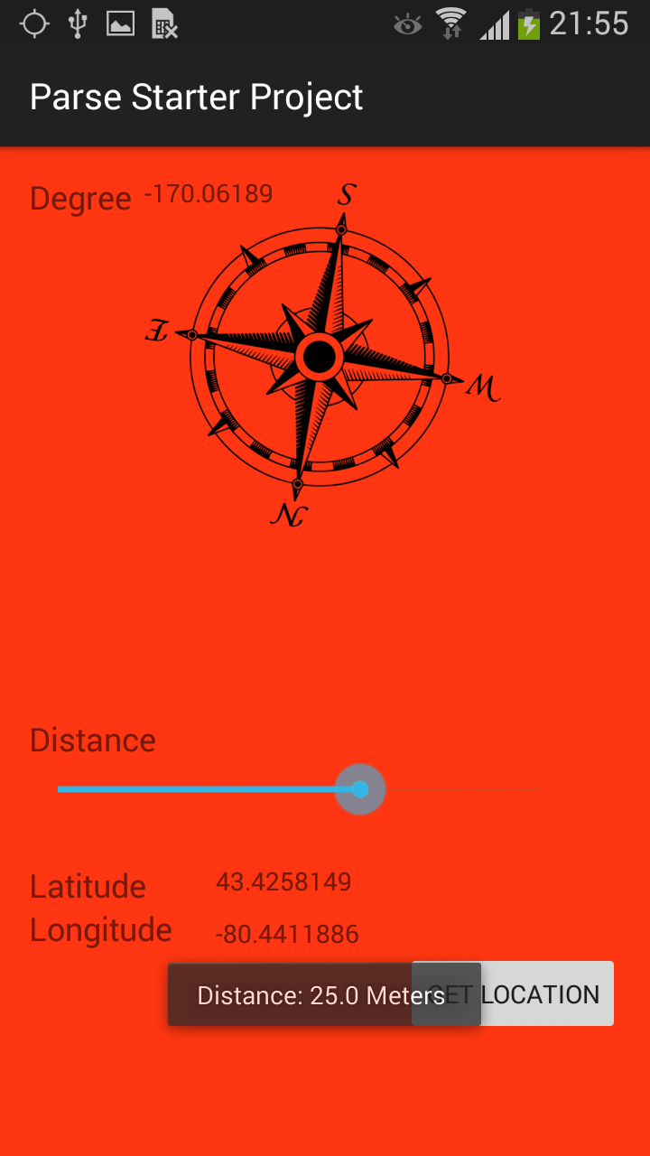
SeekBar used to set the distance with having direction and sending it parse

Slide 5
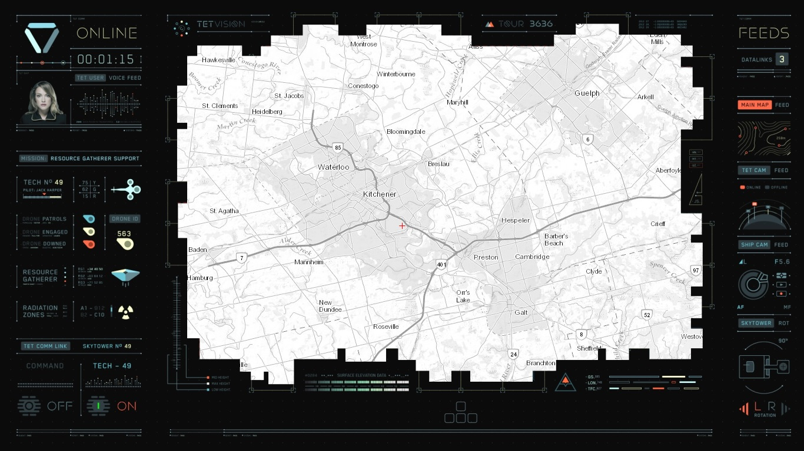
Initial

Slide 6
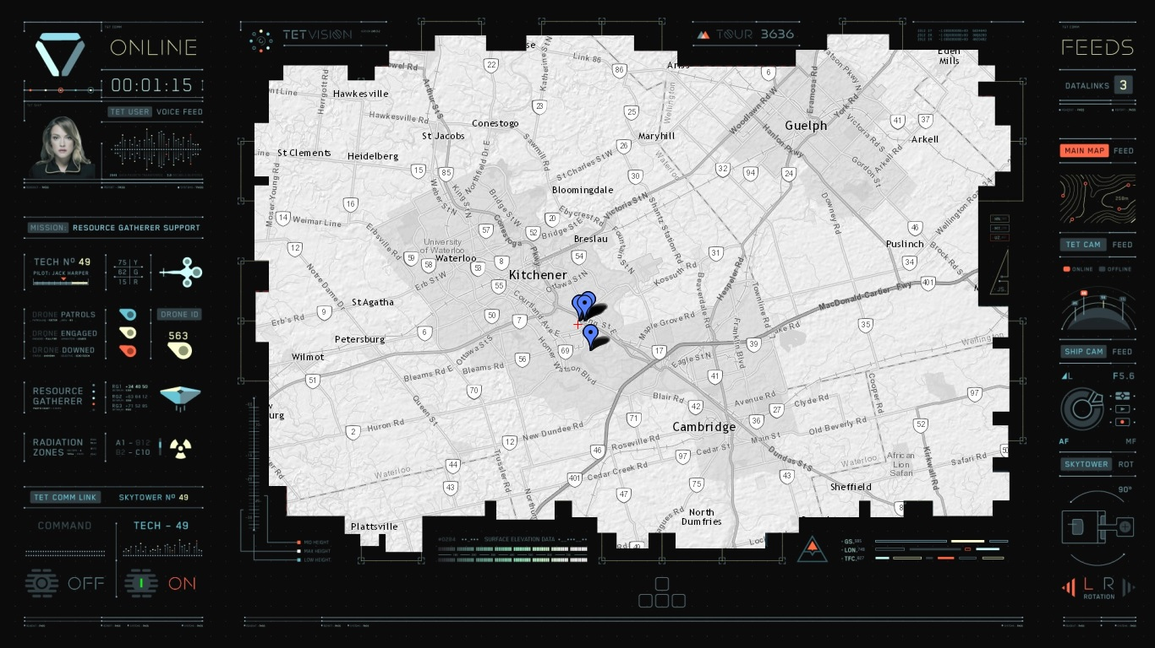
Target the locations

Slide 7
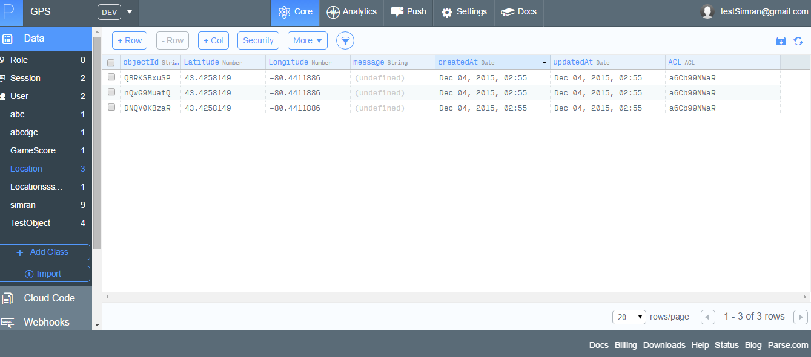
Parse Account

